Slide 1

Rapido Ride Data Analysis Using Basic SQL
Saumya Shrivastav
NIT RAipur

Slide 2

HELLO !
I am Saumya Shrivastav In this project i have solved queries realted to pizza sales using SQL

Slide 3
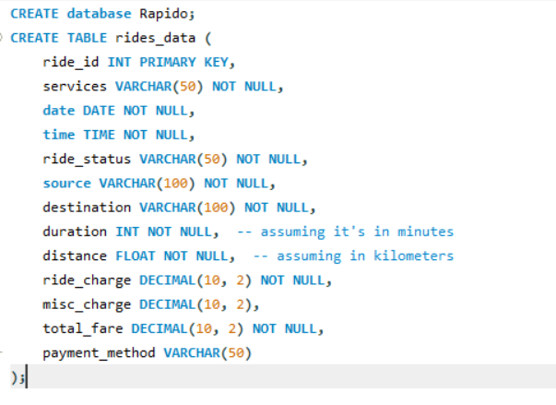
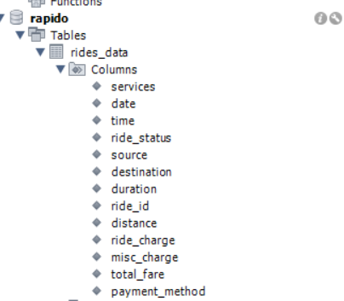
Database and Schemes

Slide 4

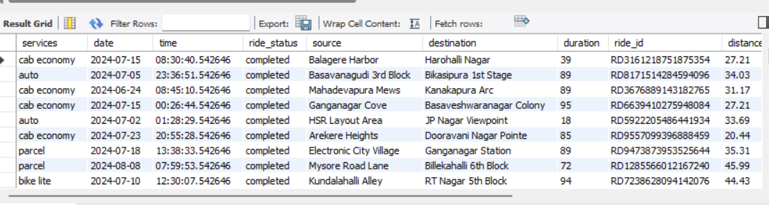
Retrieve all the complete ride

Slide 5
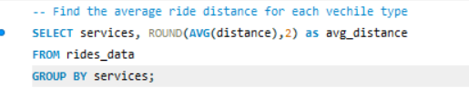
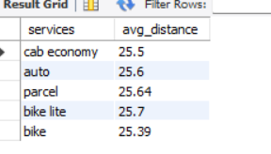
Find the average ride distance for each vehicle type

Slide 6
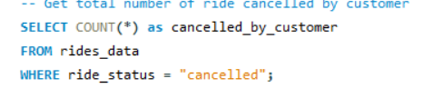

Get total number of ride cancelled by customer

Slide 7


Total revenue collected

Slide 8
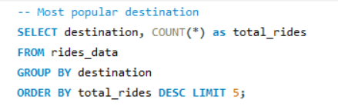
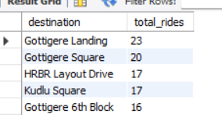
Most popular destination

Slide 9
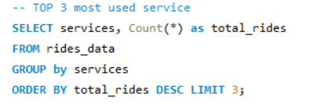
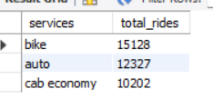
Top 3 most used service

Slide 10
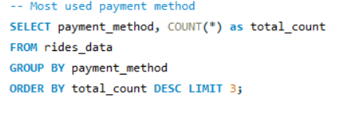
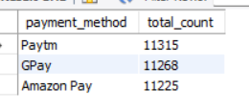
Most used payment method

Slide 11
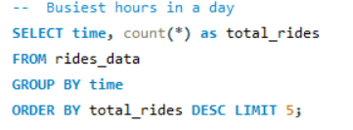
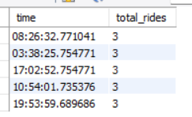
Busiest hours in a day

Slide 12
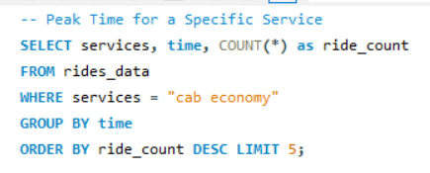
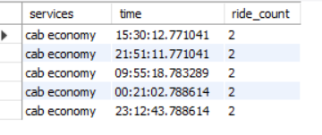
Peak Time for a Specific Service

Slide 13
Thank You

